Slide 1
Technical Deep Dive: Creating Apps for the Intelligent Cloud Day2 – Architecting for Scale
<Presenter Name>

Slide 2
Agenda
The Microservices Approach
Azure Service Fabric

Slide 3
Microservices Approach and Azure Service Fabric

Slide 4
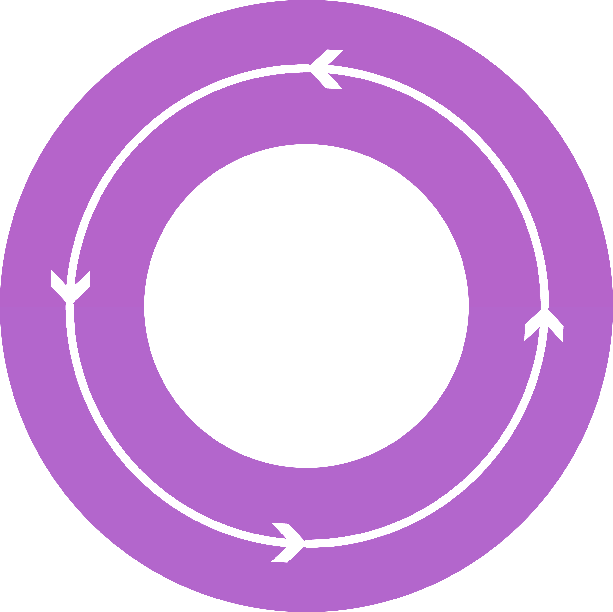



Why a microservices approach?
Continually evolving applications
Faster delivery of features and capabilities to respond to customer expectations
Build and operate a service at scale
1
4
Monitor + Learn
Plan
Development
Production
2
3
Release
Develop + Test

Slide 5


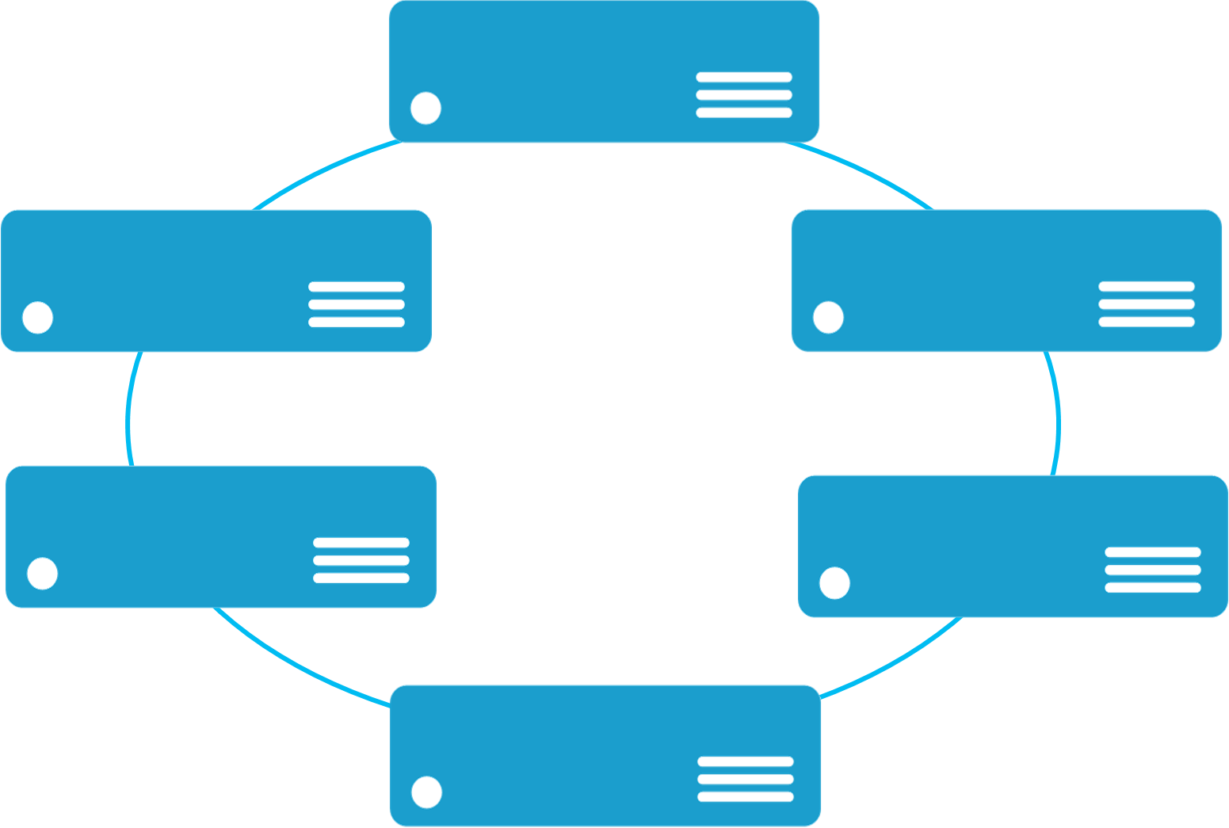


Monolithic application approach
Microservices application approach
A monolith app contains domain specific functionality and is normally divided by functional layers such as web, business and data
App 1
App 1
App 2
A microservice application separates functionality into separate smaller services.
Scales by cloning the app on multiple servers/VMs/Containers
Scales out by deploying each service independently creating instances of these services across servers/VMs/containers

Slide 6
A Microservice…
Does one thing well
Is developed by a small cross-functional team
Can be built with task-appropriate languages/frameworks
Communicates over well-defined interfaces/protocols
Has a unique logical name (URI) that can be resolved
Is independent code and configuration (& optionally state)
Scales independently
Gets upgraded independently

Slide 7
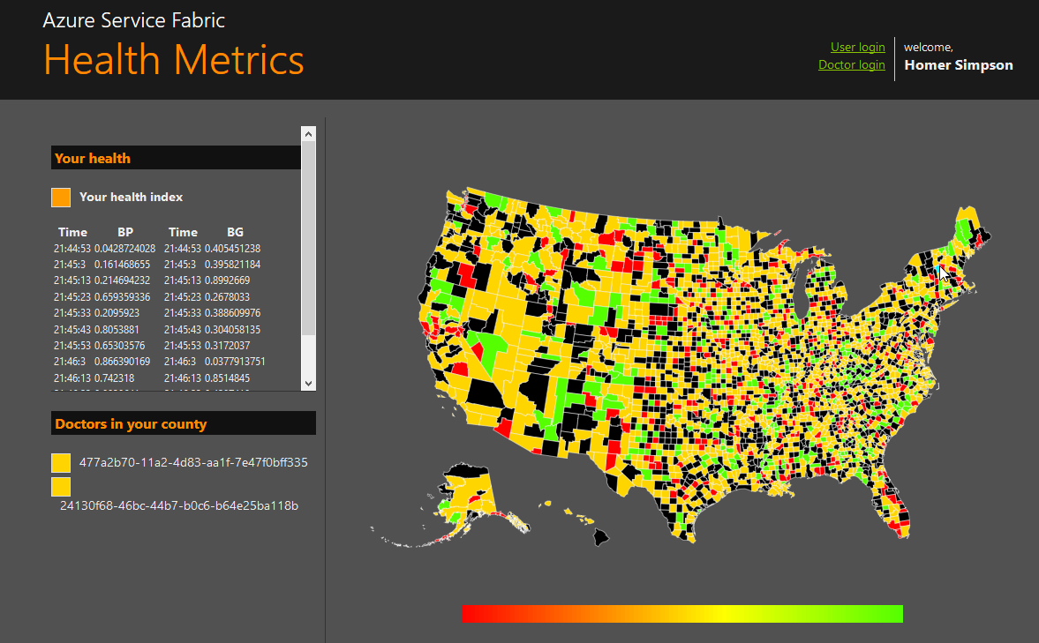
State in Monolithic approach
State in Microservices approach
Single monolithic database
Tiers of specific technologies
Graph of interconnected microservices
State typically scoped to the microservice
Variety of technologies used
stateless presentation services
stateless services
stateful services
stateless services with
separate stores

Slide 8
Azure Service Fabric
LifecycleMgmt
Independent Scaling
Independent Updates
Always On Availability
Resource Efficient
Stateless/
Stateful
Public Cloud
On Premises
Private cloud
Other Clouds

Slide 9
Cluster
Set of OS instances (real or virtual) stitched together to form a pool of resources
Cluster can scale to 1000s of machines, is self repairing, and scales-up or down
Acts as environment-independent abstraction layer
Windows OS
Windows OS
Windows OS
Fabric
Node
Fabric
Node
Fabric
Node
Windows OS
Windows OS
Windows OS
Fabric
Node
Fabric
Node
Fabric
Node

Slide 10
Types of microservices from a Service Fabric perspective
Stateless microservice
Has either no state or it can be retrieved from an external store
There can be N instances
e.g. web frontends, protocol gateways, Azure Cloud Services etc.
Stateful microservice
Maintain hard, authoritative state
N consistent copies achieved through replication and local persistence
e.g. database, documents, workflow, user profile, shopping cart etc.

Slide 11
Application type
Declarative template for creating an application
Based on a set of service types
Used for packaging, deployment, and versioning
Application Type A
Service Type 1
Service Type 2
Service Type 3
Code
Config
Data
Code
Config
Data
Code
Config
Data

Slide 12
Comparison to Azure Cloud Services
Deployments in seconds
Service lifetime decoupled from hardware/infrastructure
High Density (run many workloads on a single VM/Machine)
Allows different app types to be collocated in same environment (ASP.NET 5 Apps, other existing applications, new Service Fabric apps)
1:1 feature parity with On-Premise environment
Develop and Test on your local machine with full fidelity
Insight into your application via rich and extensible health model
World Class Orchestration & Application Lifecycle Management
Deploy, Upgrade, Reconfigure running applications with no downtime
Automatically respond to increases in load, outages, and errors

Slide 13
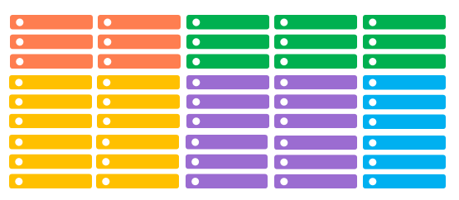
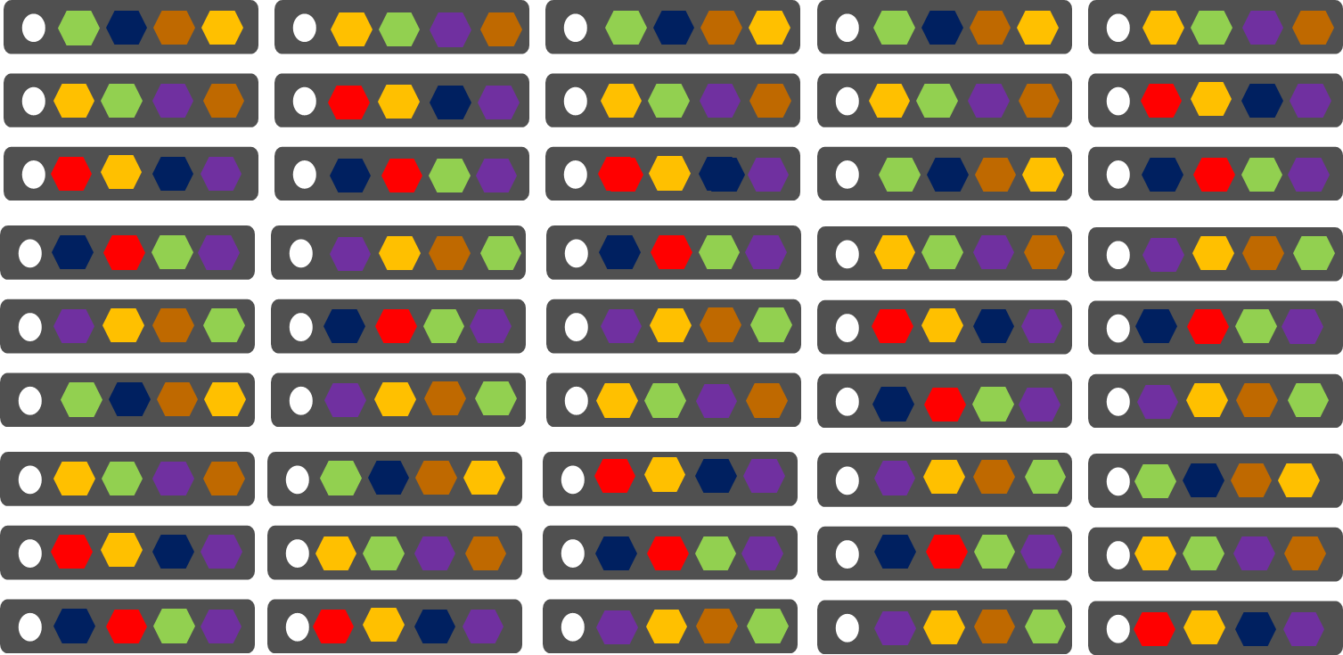
Comparing Azure Cloud Services vs. Azure Service Fabric
Azure Cloud Services
(Web and Worker Roles)
Azure Service Fabric
(Stateless, stateful or Actor services)
1 service instance per VM with uneven workloads
Lower compute density
Slow in deployment & upgrades
Slower in scaling and disaster recovery
Many microservices per VM
High microservices density
Fast deployment & upgrades
Fast scaling microservices across the cluster

Slide 14
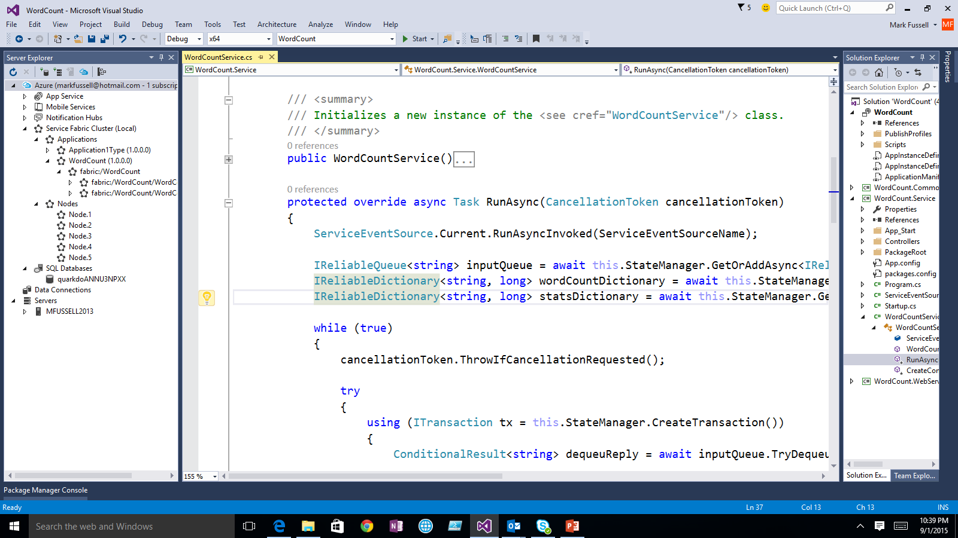
Demo: Building your first microservice with Service Fabric

Slide 15
Service Fabric cluster with microservices
App1
App2

Slide 16
Handling machine failures
App1
App2

Slide 17
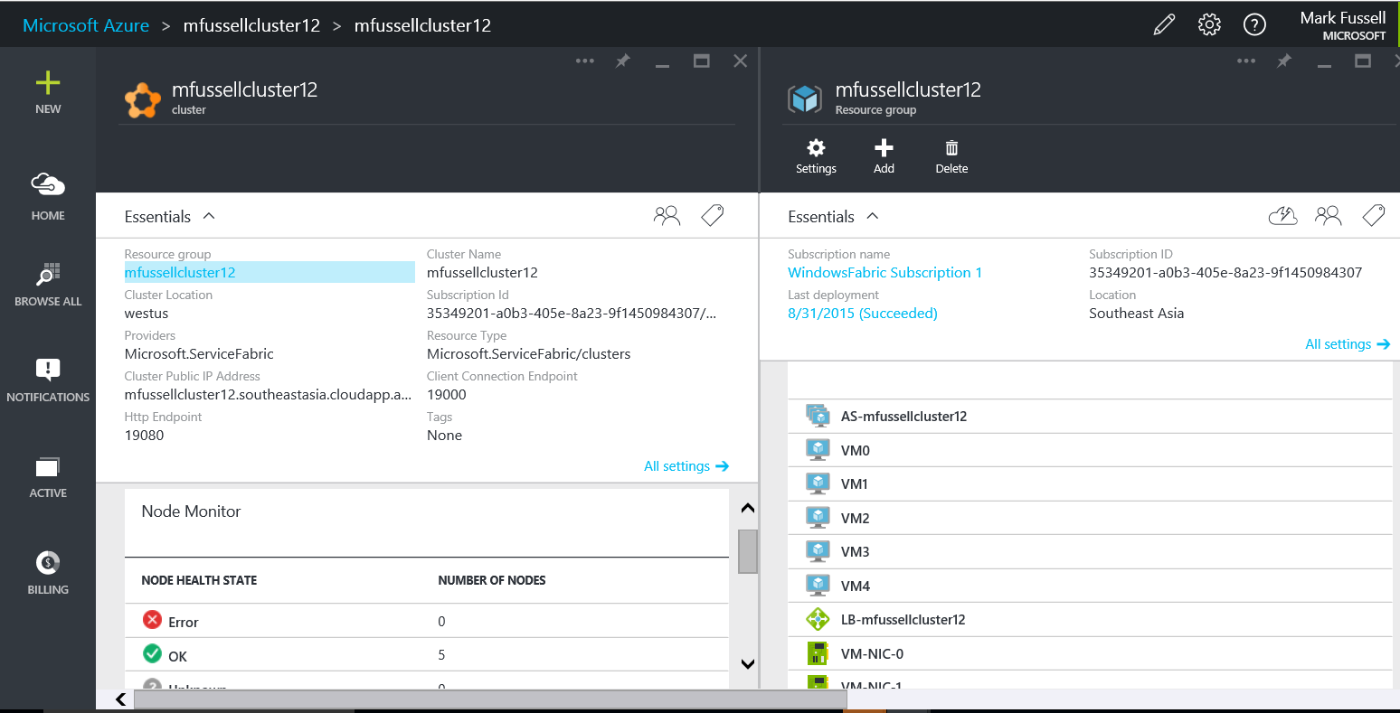
Demo: Creating a Service Fabric cluster via the portal

Slide 18
Building and managing microservice applications

Slide 19

Service Fabric
Programming Models
Web apps
Reliable Actors API
API apps
Guest Executables
Reliable Services API
LifecycleMgmt
Independent Scaling
Independent Updates
Always On Availability
Resource Efficient
Stateless/
Stateful
Public Cloud
On Premises
Private cloud
Other Clouds

Slide 20
Reliable Collections
Reliable collections make it easy to build stateful services.
An evolution of .NET collections for the cloud.
ReliableDictionary<T1,T2> and ReliableQueue<T>
Collections
Single machine
Single threaded
Concurrent
Collections
Single machine
Multi threaded
Reliable Collections
Multi machine
Replicated (HA)
Persistence (durable)
Asynchronous
Transactional

Slide 21
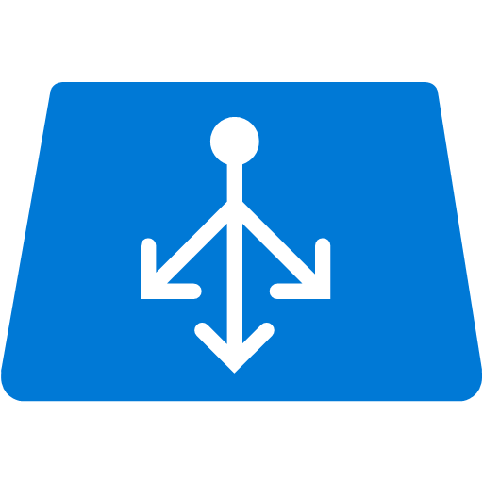


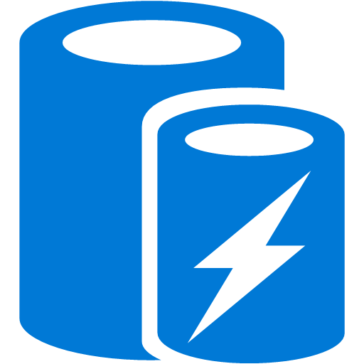


Stateless Services Pattern
Load Balancer
Scale stateless services backed by partitioned storage
Increase reliability and ordering with queues
Reduce read latency with caches
Manage your own transactions for state consistency
More moving parts each managed differently
Front End
(Stateless
Web)
Stateless
Middle-tier
Compute
Cache
Queues Storage

Slide 22

Stateful Services Pattern Simplify design, reduce latency
Load Balancer
Application state lives in the compute tier
Low Latency reads and writes
Partitions are first class at the service layer for scale-out
Built in transactions
Fewer moving parts
External stores for exhaust and offline analytics
Front End
(Stateless
Web)
Stateful
Middle-tier
Compute
Cold Data Stores
For Exhaust
(Optional)

Slide 23
Demo: Building reliable service applications

Slide 24

Stateful microservice
Application Package
replication
replication
S
S
P
S
S
P

Slide 25
What is an Actor?
An independent unit of compute and state with large number of them executing in parallel
Communicates with other actors using asynchronous messaging
Has single threaded execution (turn based concurrency)

Slide 26
Create a Reliable Actor
Define Actor Interface
public interface IHelloWorld : IActor {
... }
Implement Actor Interface
public class HelloWorldActor : Actor, IHelloWorld {
... }
Register Actor Implementation with Runtime
using (var fabricRuntime = FabricRuntime.Create())
{
fabricRuntime.RegisterActor(typeof(HelloWorldActor));

Slide 27
Running Microservices at Scale

Slide 28
Service partitioning
Services can be partitioned for scale-out.
You can choose your own partitioning scheme.
Service partitions are striped across machines in the cluster.
Replicas automatically scale out & in on cluster changes
Node 1
Node 2
Node 3
Node 4
Node 5
Node 6
S
P2
P1
S
S
S
S
P3
P4
S
S
S

Slide 29
Demo: Scaling out a service

Slide 30
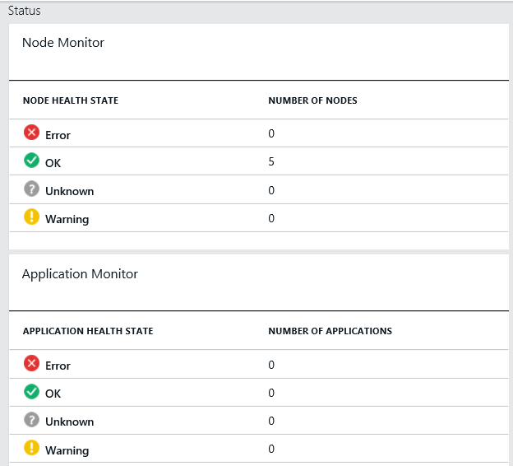
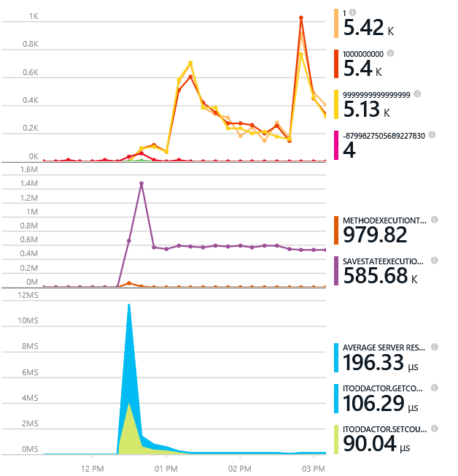
Monitoring your Services
Visibility into how your services are doing when running in production
Health status monitoring
Built-in health status for cluster and services
Flexible and extensible health store for custom app health reporting
Allows continuous monitoring for real-time alerting on problems in production
Performance and stress response
Rich built-in metrics for Actors and Services programming models
Easy to add custom application performance metrics

Slide 31
Diagnostics and Troubleshooting
Detailed System Optics
Repair suggestions. Examples: Slow RunAsync cancellations, RunAsync failures
All important events logged. Examples: App creation, deploy and upgrade records. All Actor method calls.
Custom Application Tracing
ETW == Fast Industry Standard Logging Technology
Works across environments. Same tracing code runs on devbox and also on production clusters on Azure.
Easy to add and system appends all the needed metadata such as node, app, service, and partition.
Choice of Tools
Visual Studio Diagnostics Events Viewer
Windows Event Viewer
Windows Azure Diagnostics + Operational Insights
Easy to plug in your preferred tools: Kibana, Elasticsearch and more

Slide 32
Application Upgrade
Upgrade Domain #1
Upgrade Domain #2
Upgrade Domain #3
App Repository
Windows OS
Windows OS
App A v1
Windows OS
App C v2
App A v1
App C v1
Fabric
Node
App B v2
Fabric
Node
Fabric
Node
App B v2
App C v2
App C v1
App C v1
App C v2
Windows OS
Windows OS
Windows OS
Fabric
Node
App B v2
App C v2
App B v2
App C v1
Fabric
Node
App A v1
App A v1
Fabric
Node

Slide 33
Demo: Upgrade

Slide 34
Contact Us Technical services to help you win more deals, accelerate deployment and increase consumption
Microsoft Azure
http://aka.ms/PartnerTechnicalServicesAzure
Microsoft CRM Online
http://aka.ms/PartnerTechnicalServicesCRMOnline
Microsoft Office 365
http://aka.ms/PartnerTechnicalServicesO365
Microsoft Windows 10 and Enterprise Mobility Suite
http://aka.ms/PartnerTechnicalServicesWin10EMS
Learn more about your technical support benefits
http://aka.ms/MySupport

